Slide 1
Online_Food Project
File created on: 3/13/2024 2:30:10 PM

Slide 2
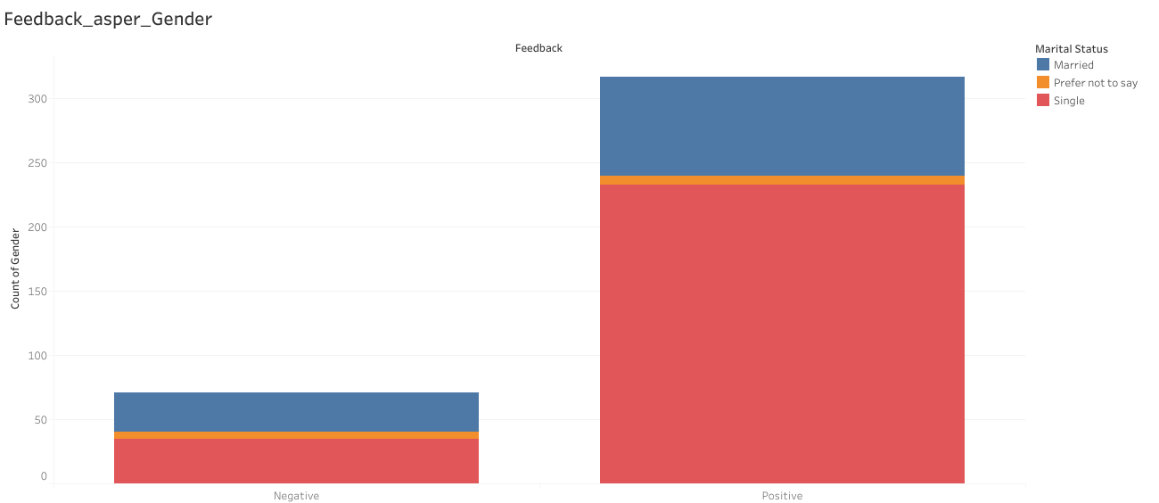

Slide 3
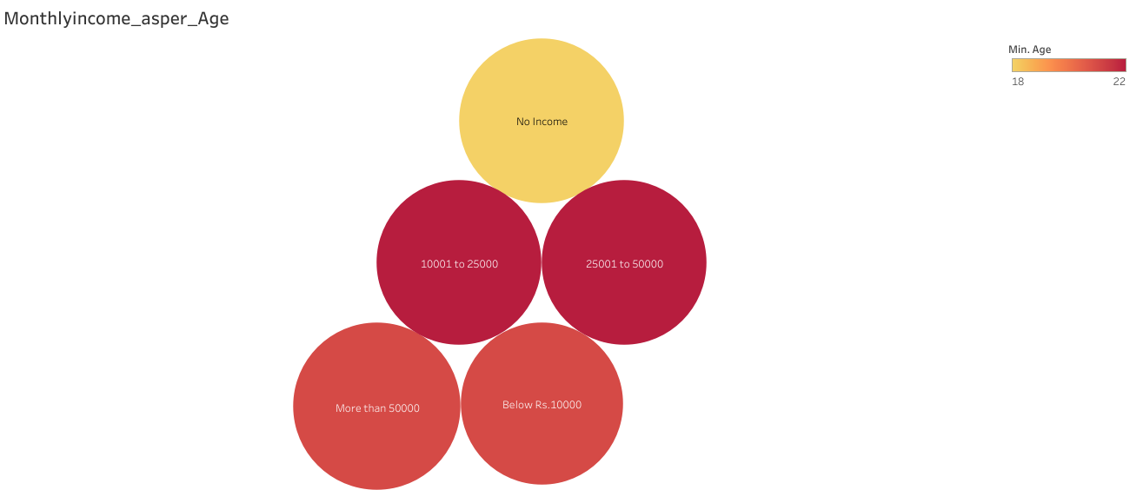

Slide 4
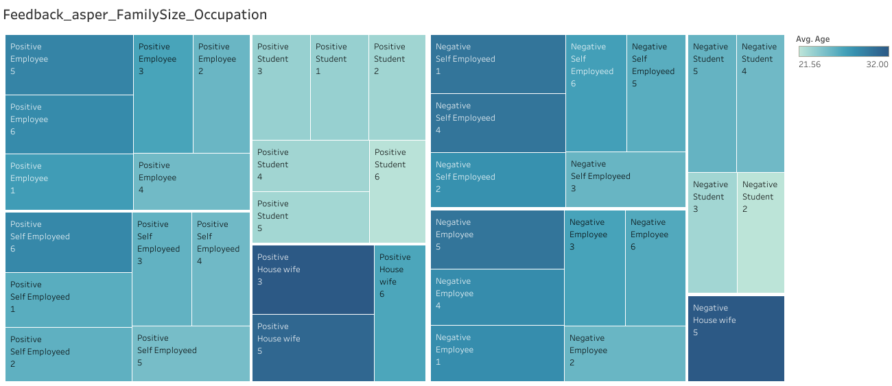

Slide 5
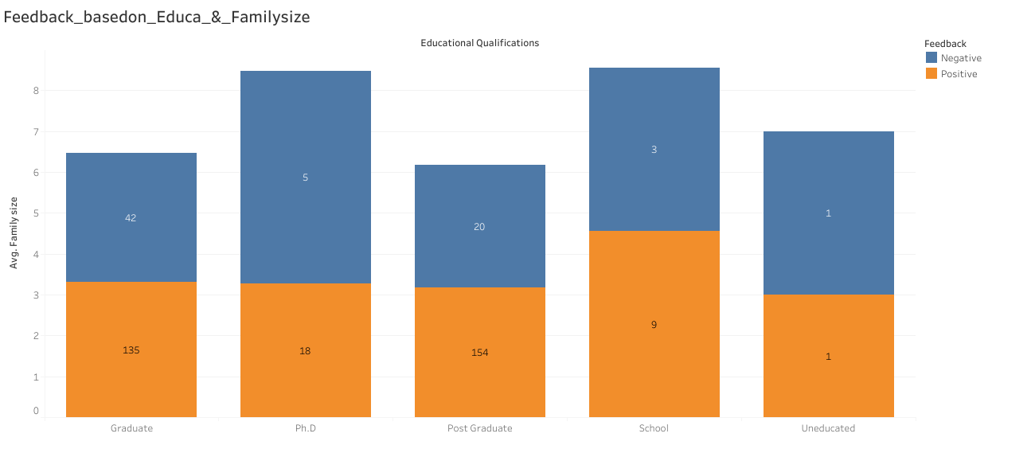

Slide 6
